Slide 1
PPE for Normal Operations

Slide 2
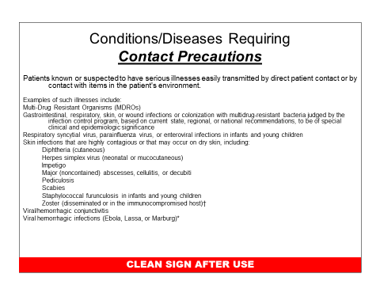
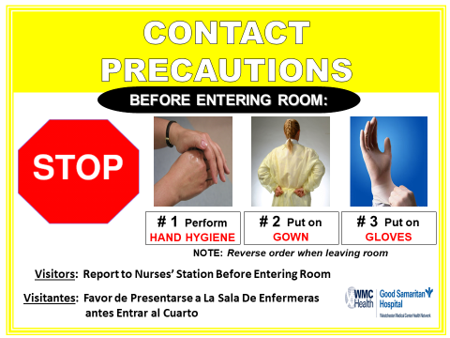
Contact Precautions
Organisms can be spread by direct contact with infected or colonized patient or indirectly with contaminated objects (fomites).

Slide 3
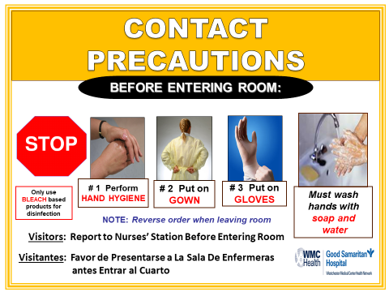
Contact Precautions
Contact Precautions for organisms that are spore forming, highly pathogenic/ drug resistant or especially hearty sometimes require
Soap and water hand hygiene
Use of bleach for low level disinfection.

Slide 4
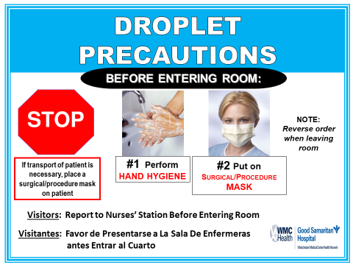
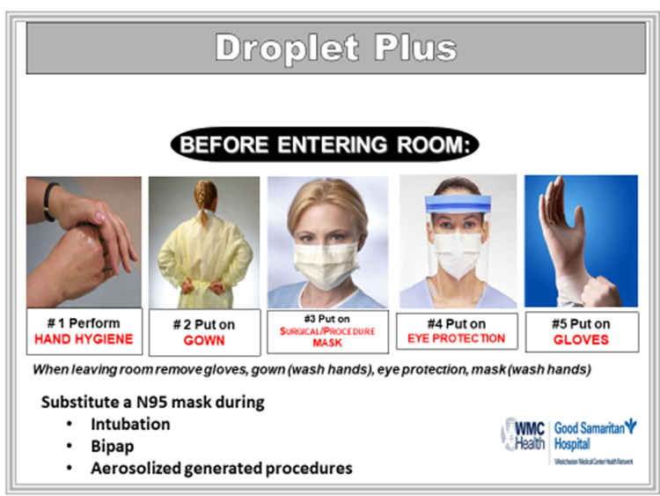
Droplet Precautions
Transmission occurs when droplets containing microorganisms from the infected person are propelled a short distance through the air and deposited on the susceptible hosts conjunctivae, nasal mucosa, or mouth.

Slide 5

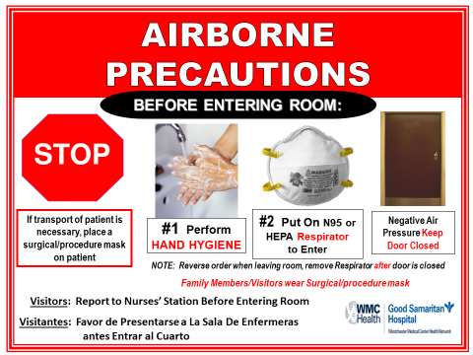
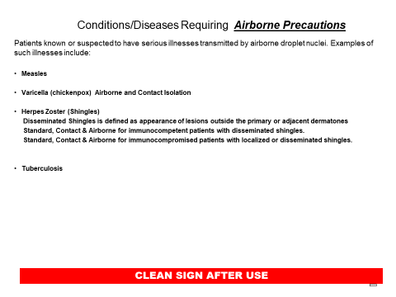
Airborne Precautions
Airborne transmission occurs by dissemination of either airborne droplet nuclei (small particle residue that is 5μ or smaller in size) containing microorganisms that remain suspended in the air for long periods of time.

Slide 6
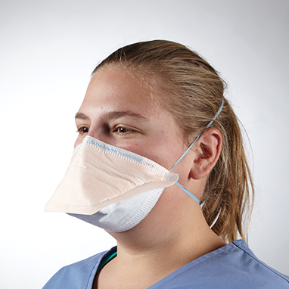

Slide 7
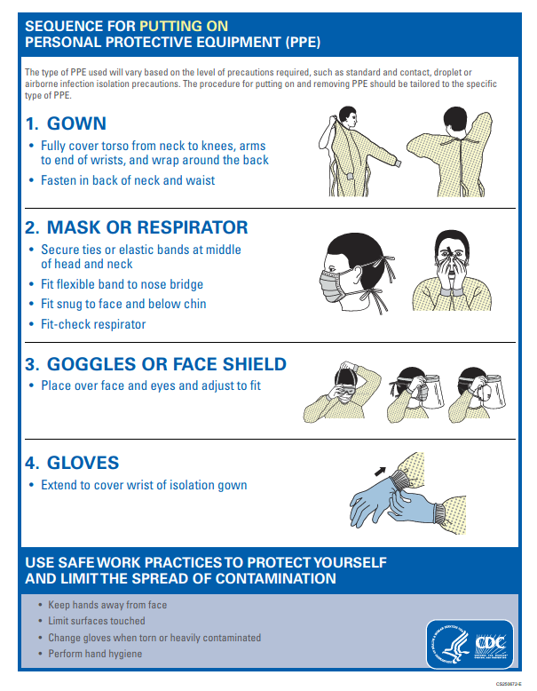

Slide 8
SEQUENCE FOR REMOVING PERSONAL PROTECTIVE EQUIPMENT
After providing patient care, remove PPE in the following order:
Gloves: Outside of gloves are contaminated. Grasp outside of glove with opposite gloved hand and peel it off and discard in trash container
  Leave the room and wash hands outside if sink is available outside the room or use alcohol hand rub if hands are not visibly dirty or caring for a patient with C. difficile.
Goggle: Outside of goggle is contaminated; handle by head band or ear pieces
Gown: Front and sleeves of gown are contaminated.
  Untie waistband and neck band of gown and pull away from the neck and shoulders, touching inside of gown only
  Turn gown inside out, fold or roll into a bundle and discard it in the Hamper inside the room
Mask: Front of mask/Respirator is contaminated – Do not touch! Grasp bottom, then top ties or elastics and remove. Discard in trash container inside the room

Slide 9
Considerations for Transportation on Precautions
Limit transport and movement of patient’s outside of the room to medically-necessary purposes
When transport or movement is necessary, place patient in a clean gown and cover patient with a clean sheet. If transporting the patient in their bed wipe the side rails down with the appropriate “Sani-Wipe” Bleach for C-diff and/or C. Auris, Grey top for all others.
Remove and dispose of contaminated PPE and perform hand hygiene prior to transporting patient’s on Transmission-based Precautions
Don clean PPE to handle the patient at the transport destination

Slide 10
Considerations for Transportation on Precautions
No gloves or gowns in the hallway
Shoe covers should not be worn by any staff that is not in a clean area such as the OR
Mesh/netted hair coverings are limited to appropriate settings
Face shield should not be worn outside patient treatment areas such as rooms or bays

Slide 11

OR attire is for the OR
Staff members wearing OR attire should not be outside the building in this garb.
Please enter and exit the building in your personal clothing.

Slide 12
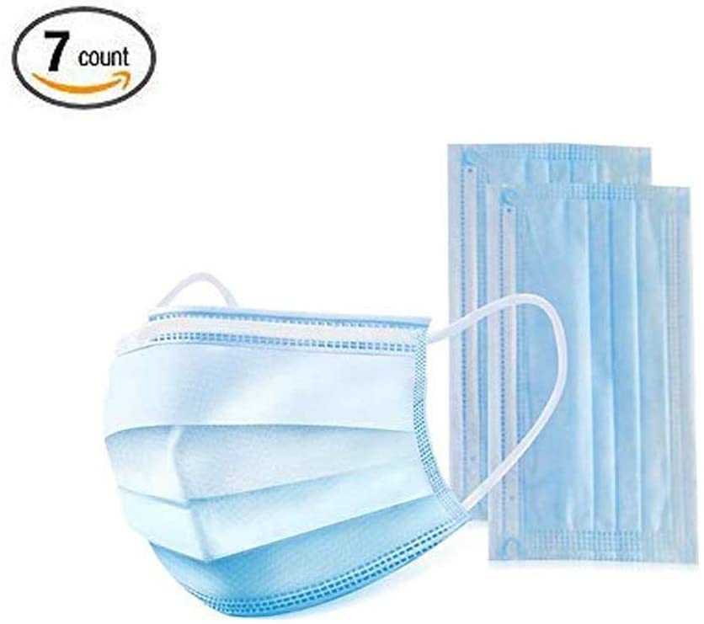
Masks
Due to the Covid- 19 crisis and following advisement from the CDC and state of NY we require the use of masks in all public areas of the hospital.

Slide 13
References
Information taken form Centers for Disease Control and Prevention
Please consult www.cdc.org for most up to date information and guidelines.

